Slide 1
Recruitment and beyond @ Thales

Slide 2
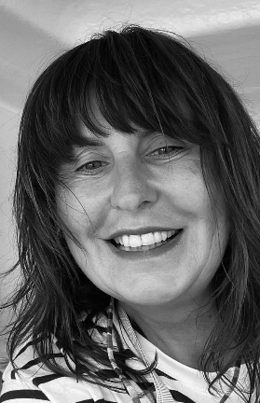
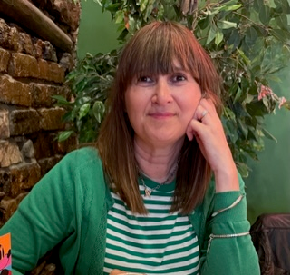
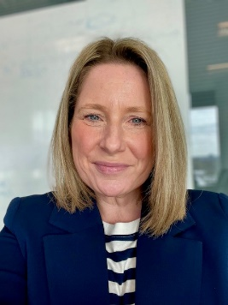
Your team for today…….
Kirsti Godson
Head of Social Impact
Claire Angliss
Head of Learning and Talent, Learning and Culture Specialist
Lindsey Beer
Talent, Learning and Culture Director

Slide 3
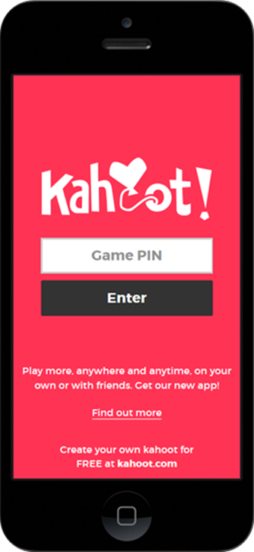
What do you know about Thales Quiz?
Joining the Quiz Option One | Joining the Quiz Option Two
Open www.kahoot.it in web browser | Scan QR Code to enter the quiz when prompted
Input Game PIN to join quiz when prompted
Enter your nickname | Enter your nickname
Click “OK, go!” | Click “OK, go!”
Play!! | Play!!

Slide 4
The talent market has changed forever!
The Great Resignation
62%
Of employees explored a career change in the last year…
Three in four
People who are looking for a new role are interested in external roles
94%
Of employees say it’s more or just as important now than before Covid-19 to develop skills outside their roles…
15 year high
Of talent shortages with 69% of employers reporting difficulty in filling vacancies
51%
Would choose a role that paid less for better flexibility

Slide 5
What the experts say!
“To attract top talent, employers must offer a working environment that is appropriate for the new world of work, including job flexibility, authentic leadership, diversity, etc. Organisation’s succession challenges and ability to attract and return top talent in a tightening talent market may limit ability to achieve operational targets.”
*Forbes Published Jan 2023
“Shared purpose: 53% of employees want their organizations to take actions on issues they care about.”
“Person-first experience: 82% of employees say it’s important for their organization to see them as a person, not just as an employee”
*Gartner Jan 2023.

Slide 6

Talent the big questions!
How do we increase speed and build resilience in our people and our organisation?
How do we truly balance in person and remote working
How do we walk the talent tightrope and engage in attraction, retention, exit and attrition?
How do we close the capability gap?
How do we make real progress on diversity, equity and inclusion?

Slide 7
Areas of focus for Talent Learning and Culture
05
04
03
A learning company, with a learning mindset
02
Volunteering, to help those less fortunate and open up opportunities for all
01
Leadership acquisition and capability
Focus on school partnerships to build STEM skills for the future and support skill shortages i.e AI & Tech
Widening acquisition efforts to focus on untapped and non-traditional talent, e.g different ethnicities, veterans, women in STEM and young people through apprenticeships

Slide 8
Place saver Driving Talent video

Slide 9
What is Social Impact and why is it important?
Social Impact measures the positive value businesses create for the economy, communities & society
Simply put, for Thales it is an enabler for our employees to develop and learn in creative ways that empower and equip them to give back to the communities in which they work & live.

Slide 10




The Business Rationale for Social Impact
Volunteering creates Learning opportunities
Learning Mindset
EDI Agenda
Our activity targets minority groups – women in STEM, veterans, those who are economically and socially disadvantaged
Social Impact & Volunteering
Ways of Working
Thales UK offer 24 hours paid volunteering to all staff and 80 hours to Early Careers community
Positive change that addresses our social challenges and is the red thread to all our work - providing a sense of purpose & pride
Social Impact
Bid Winning
Social Value commitments are now a key element of customer requirements
Notes:
69% of the world’s most admired companies value learning agility and curiosity over career history and experience when it comes to hiring
75% of workers say they expect their employer, and business in general, to be a force for good in society. This percentage reaches 80% for those under 45 years old.

Slide 11






Some of the benefits for our employees
Learning & Development
Connections
Creating networks both internally and externally
Develop skills in a real world context whilst giving back to the community
Drives Performance
& Retention
Societal Context
Increased effectiveness, collaboration and retention
Better understanding of social issues
Connect & Align Values
Brand Awareness
Employees have a shared purpose and meaning to work. Human connection is vital for workforce to be happy
Potential employees look for organisations who are ethical and make a difference

Slide 12





School Engagement, building skills for the future.
  Only 25% of English Students take 2 or more STEM subjects at A level…
Only 17.5% of engineering teachers a relevant post-A level qualification…
Target Schools with a diverse intake
Supporting Teachers
STEM activities
Work Experience
47% of 11-19 year olds said they knew little or almost nothing about what engineers do…

Slide 13
Place saver for STEM Video

Slide 14
A Learning Organisation that values difference, with a sense of purpose, our people can connect with, driving people engagement and business performance

Slide 15

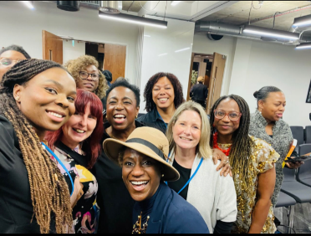

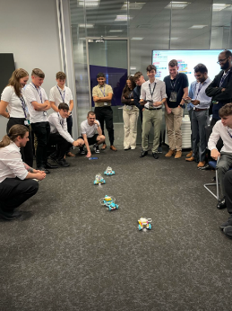
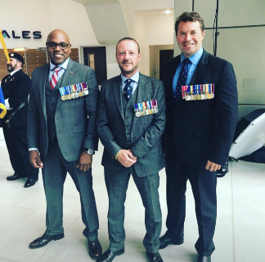
Diversifying employability to build better talent pipelines
Ethnic Minorities make up 10.8% of the engineering workforce
What are we doing:
Work Experience
Career Talks
Interview Skills
Sponsorships
Measuring
12% of engineering employees are women
Working age ex-forces in the UK are nearly twice as likely to be unemployed as their civilian contemporaries

Slide 16
What our people say……
“Being a socially conscious and responsible business shows that Thales is compassionate and treats all people, including employees, well. It’s a good indication of what the working culture is like.”
“I think it’s a great way to have new experiences and in a time where our generation wants to explore the world and values experiences, volunteering is a great way to be able to open this door and allow people the opportunity to do things that they wouldn’t have been able to so easily do.”
“Companies that are present in their local community and help inspire the next generation are at the forefront of prospective career choices as they have created a lasting impact in their journey.”
“I want to raise awareness of engineering as a career choice and the routes that can be taken to work in this sector. Also to show how theoretical knowledge can be applied and to promote opportunities that weren’t available to me during primary or secondary education.”

Slide 17
Place saver for Learning video

Slide 18
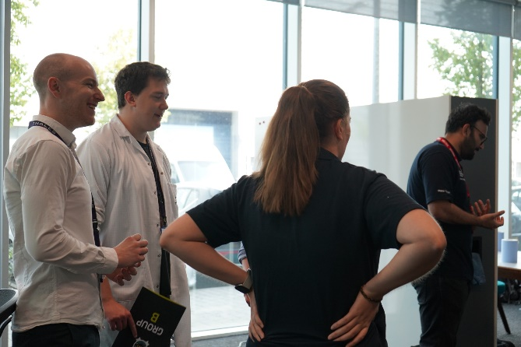
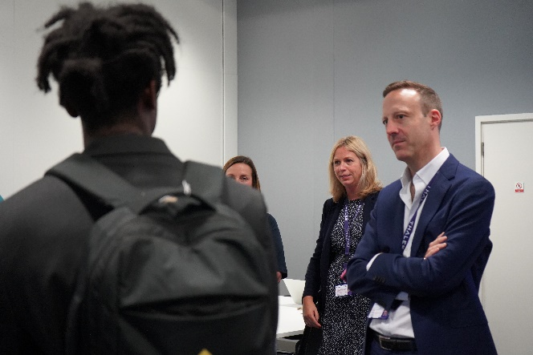
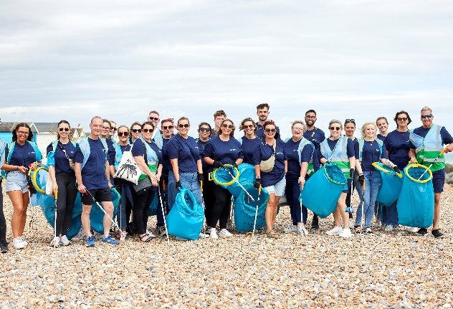
Take Away
Find time to learn!
Use it to disrupt things
Invest in the selection
& development of
people leaders
Find opportunities for people to give back!

Slide 19
In your tables discuss the following questions
One thing you will share with your work colleagues about what you learned today? | What will you commit to doing as a result of today - it could be either an action or behaviour change? | What do you want to know more about?

Slide 20

Manor Royal BID
Question time
With
Aidan McHugh, BDO Eaton Square
Lindsey Beer, Thales UK

Slide 21
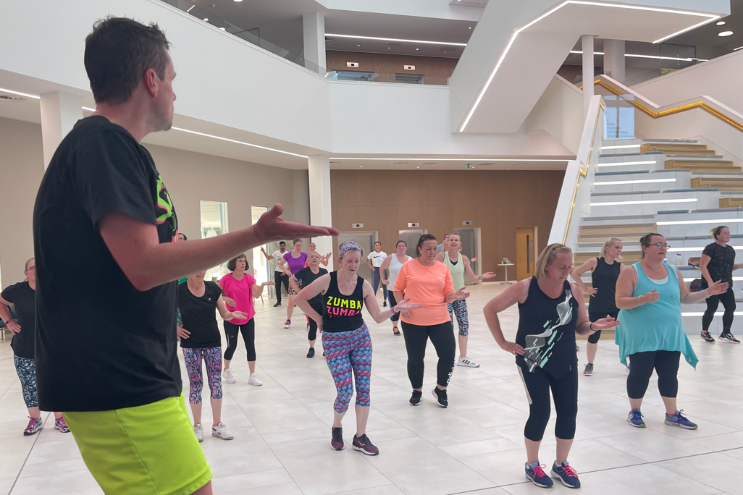
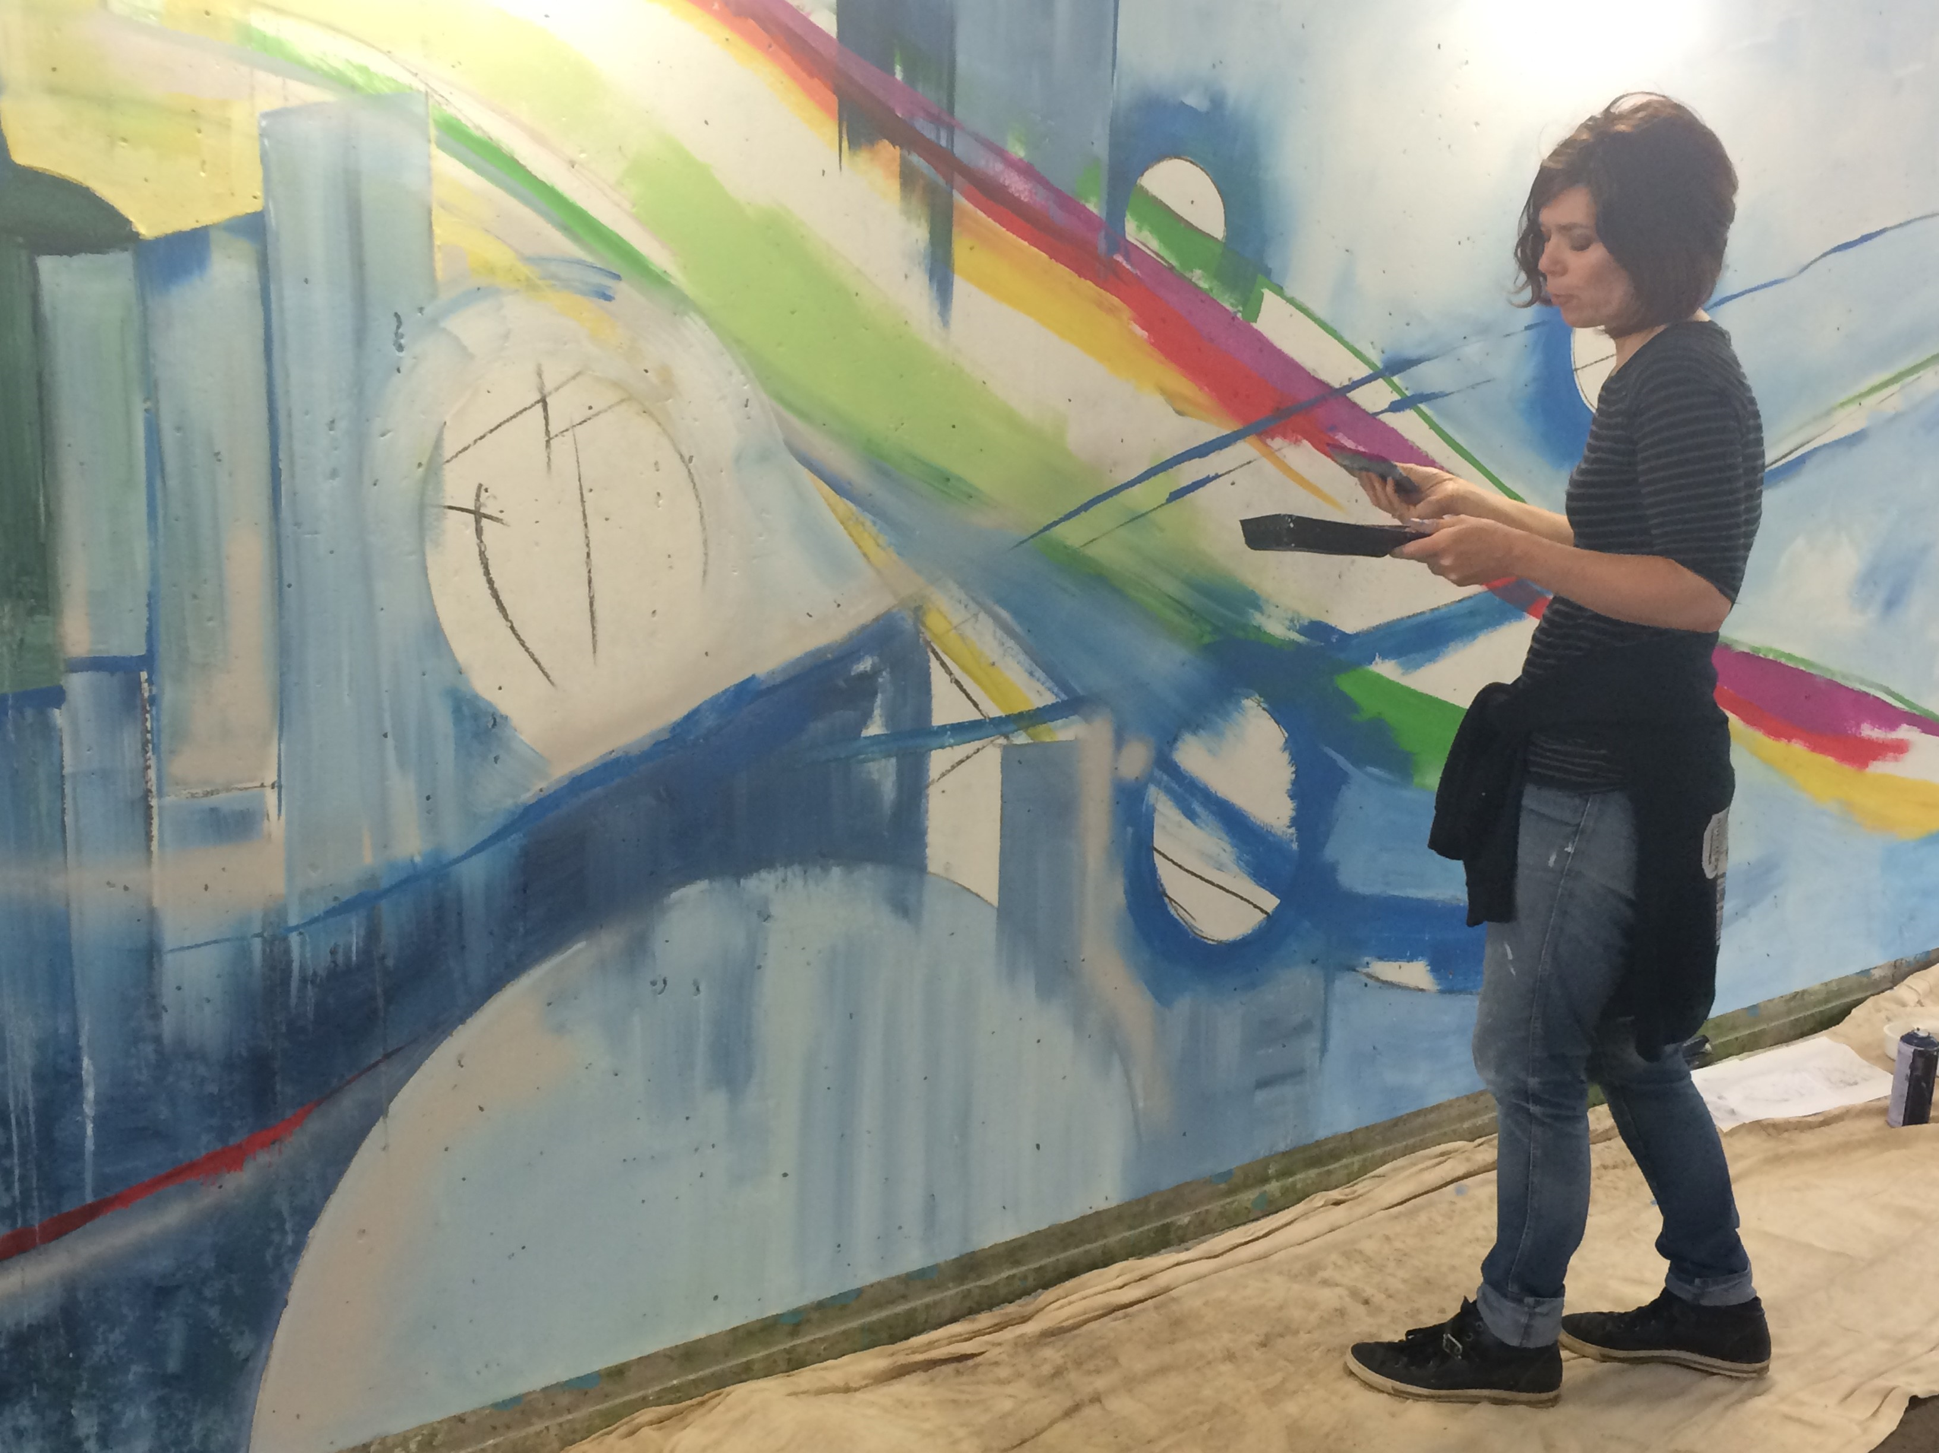
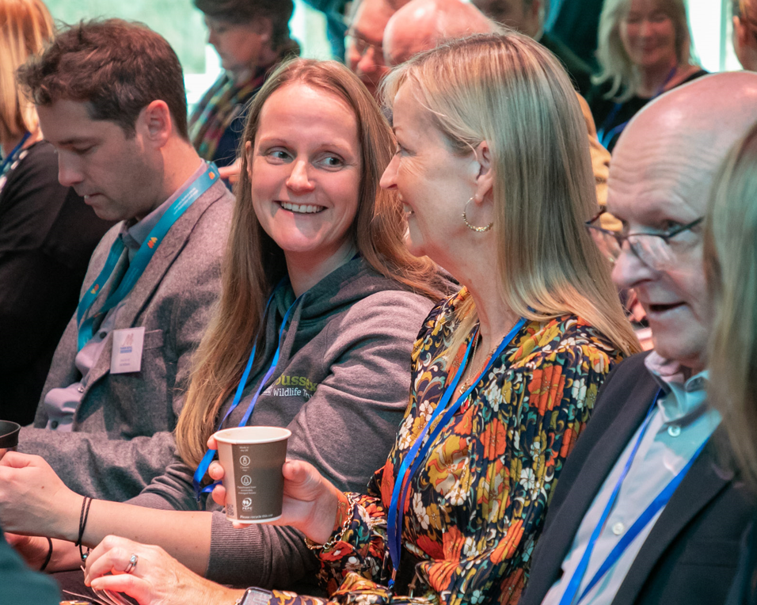
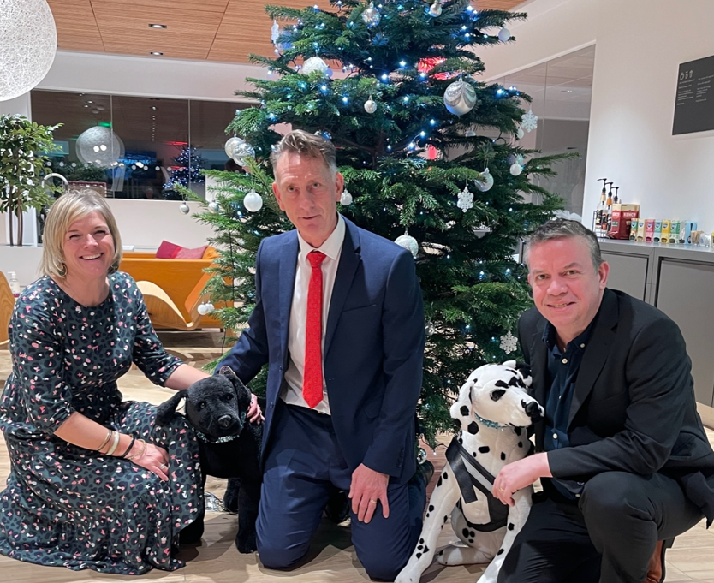
Thank you….see you soon
Where arts, culture & business collide
What?
Celebrating the creativity and art of Manor Royal. Meet the artists. Discover the Creative Playground.
When?
17 October
@ Gatwick Production Studios
Manor Royal Matters 2023
What?
Includes Annual Review, a celebration of 10 years of the BID, “what matters” sessions, exhibition & networking.
When?
08 November
@ Sandman Signature Hotel
Christmas at CAE
What?
Fun, social festive even with music, nibbles, good company and a chance to win a ride in a simulator.
When?
13 December
@ CAE
Charity Zumba-thon
What?
Charity Zumba-thon event at Elekta. All proceeds to charity. All welcome.
When?
04 October
@ Elekta
www.manorroyal.org/events

